Slide 1
Analysis of the Mobile Development Ecosystem
Doing the dirty work so you don’t have to!

Slide 2
What is all the hype for by the way?
The ability to shrink humongous applications to sizes that fit into the devices of the common man whilst meeting all the needs that other kind of applications do cannot by any means by overstated.

Slide 3


1. Mobile Application Ecosystem
Types Types of Mobile Applications
Differences Differences between the aforementioned types of applications

Slide 4
Types
Native Applications: Ever wondered that favourite app of yours seems so fast and performant? It probably is because of the absence of an abstraction layer that enables the developer to access the core features of the device directly.
Take Erlang, the language on which Whatsapp is built as an example

Slide 5
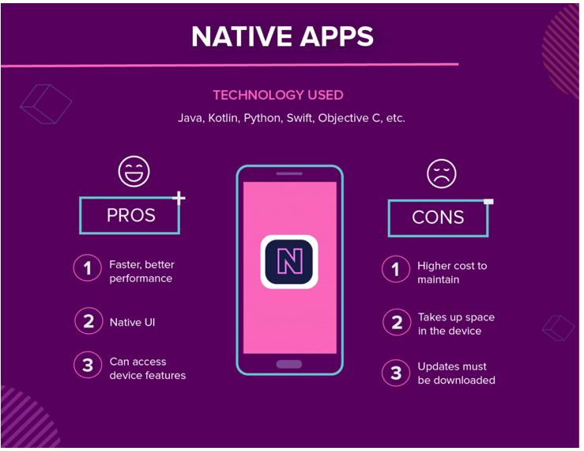
LET’S
COMPARE

Slide 6
Types
Web Applications: These ones, like the name suggests run on web browsers such as Safari or Chrome. On their own, they are pretty meaningless. They are usually written with web tools such as HTML, CSS, Javascript etc though the advent of Web assembly(WASM) and leptos(Rust library) are beginning to gain a foothold in this space as well

Slide 7
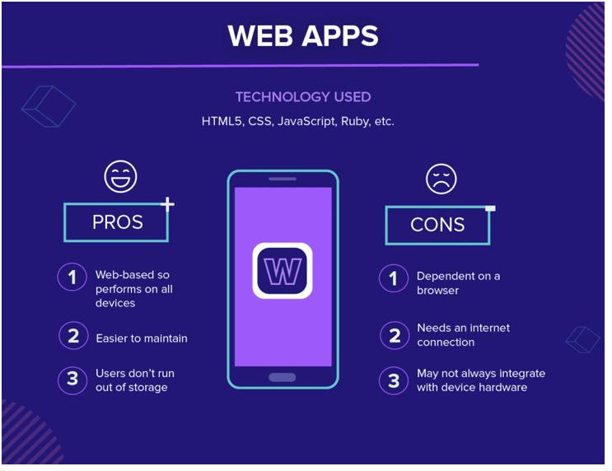
LET’S
COMPARE

Slide 8
Types
Hybrid Applications: Remember what we said about native apps having no extra layer of abstraction between the code and the device? Well these ones could be written still with web technologies but this time around, wrapped in a native container(ABSTRACTION) through which they access the required internals of the mobile device

Slide 9
Types
Hybrid Applications: They usually can run on multiple platforms or OSs such as Linux, MacOs and Windows and can be developed with frameworks such as Ionice, Flutter and React Native

Slide 10
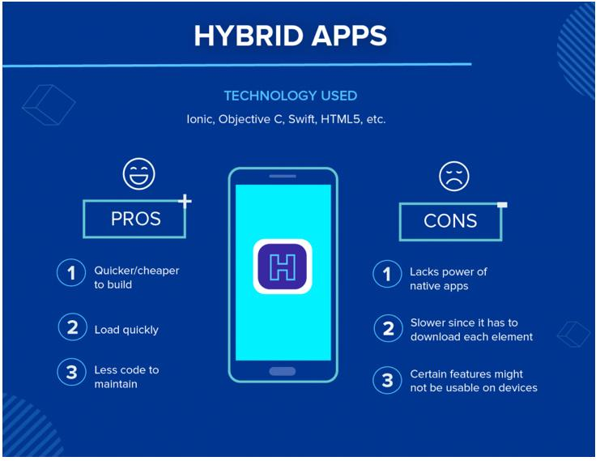
LET’S
COMPARE

Slide 11
2. Language Review
Languages used for mobile development
Language Review

Slide 12
A bazillion languages exist but we’ll focus on these few!
Java
Kotlin
Swift
Objective C
Javascript

Slide 13
Java and Kotlin
These two are beasts in the Native android ecosystem. If you’re thinking native in the android world, you can do better than either of these two. Slightly similar in syntax but different in their own right

Slide 14
Swift and Objective C
These two are the analog of Java and kotlin but this time, in the IOS world. You really can’t do any better unless you’re not interested in dealing with the metal

Slide 15
Javascript and Typescript maybe?
These are a powerhouse in the web space but if you’re looking for build once, run anywhere tools, you can’t look past Javascript. Easy barrier of entry with a factory of frameworks to make your life as easy as possible

Slide 16
Any others?
Other incredible options are Ruby, C#, Python and even PHP. They come with some powerful frameworks of their own and of course, drawbacks like the others.
Choose wisely!

Slide 17
3. Mobile Frameworks
What is it anyways?
Types and Comparism

Slide 18
What is it?
A collection of pre-written code and tools that developers use to build quickly and more efficiently.

Slide 19
What is it?
They usually provide a lot of boilerplate thus, reducing the amount of code the developer has to write. This results in better developer experience(DX)

Slide 20
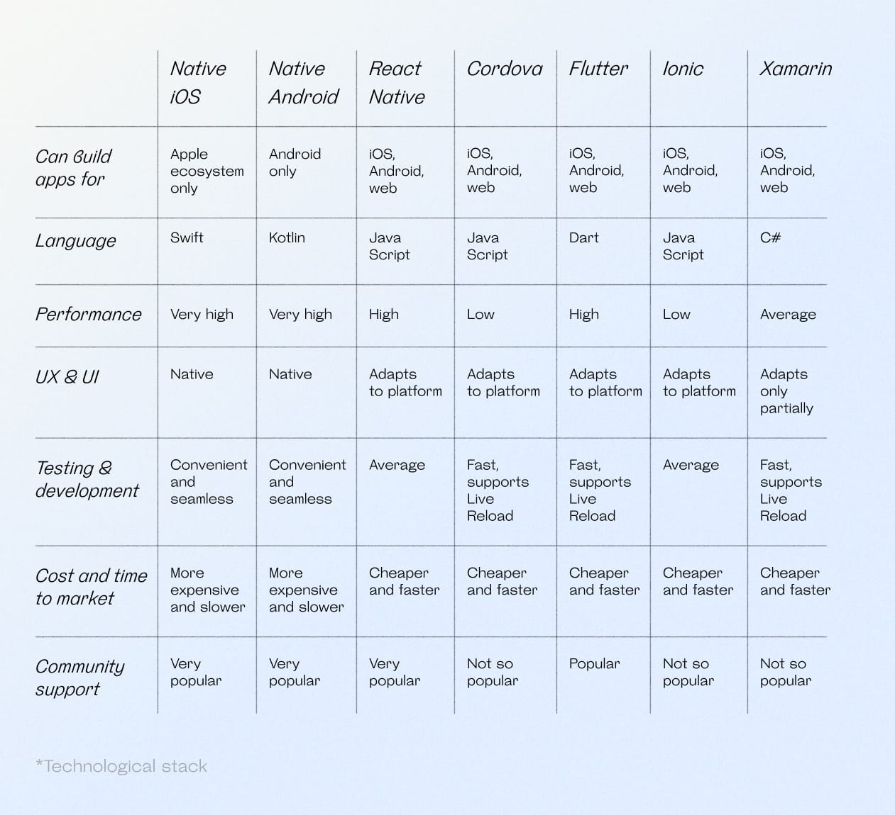

Slide 21
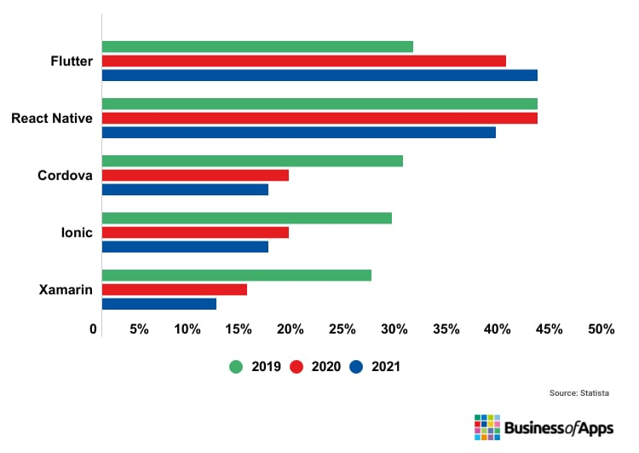

Slide 22
4. Development Cost analysis
How do you collect requirements and come up with cost estimations?
How to estimate cost

Slide 23
There are about seven steps to consider when doing cost analysis
Determining stakeholders: Who are they and what is their level of involvement in the project
Requirements Gathering: What do you need at every level to realise the project’s goals?
Define Functional Requirements: What are the features and functionalities the mobile application should provide

Slide 24
Define Non functional Requirements: What characteristics are important but not necessarily with respect to its functionality?
Requirements Analysis: Are they sufficient, incomplete or just plain wrong? Could they be better?
Create Requirements Specification: Prepare an SRS document that outline all requirements, specifications in detail for the mobile application

Slide 25
Validate Requirements: Ensure together with stakeholders that the requirements are complete, consistent and accurate
You should be confident in starting the project after following all these steps
NB: This is the ideal case. Sometimes, you’ll have to cut corners to get things done but where possible , do things right!

Slide 26
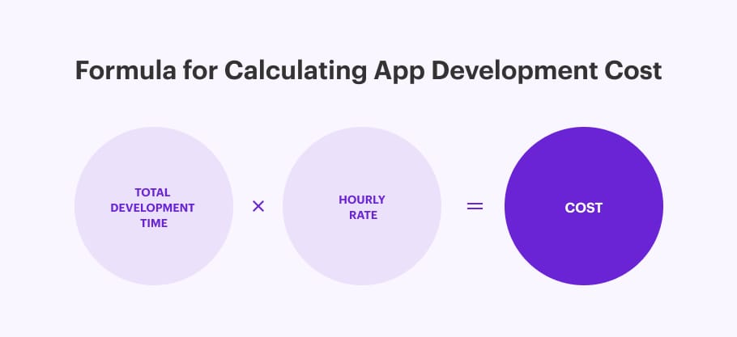
But How Do You Estimate Costs After All? This Formula should explain it succinctly!

Slide 27

Thank You!

